Slide 1
Developments in the US: STAR & U METRICS

Slide 2
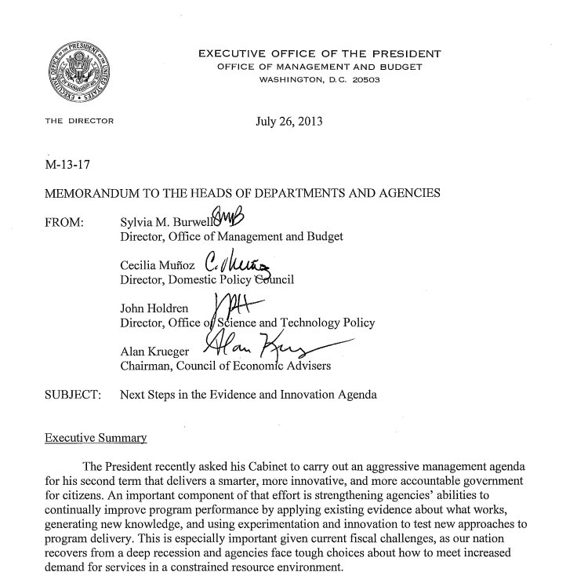
Motivation
The President recently asked his Cabinet to carry out an aggressive management agenda for his second term that delivers a smarter, more innovative, and more accountable government for citizens. An important component of that effort is strengthening agencies' abilities to continually improve program performance by applying existing evidence about what works, generating new knowledge, and using experimentation and innovation to test new approaches to program delivery.

Slide 3
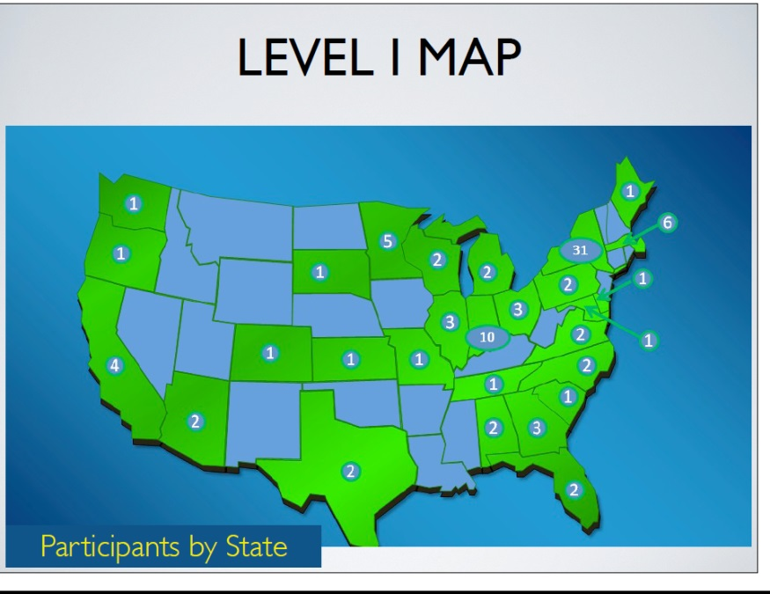
STAR METRICS
National program: White House led inter-agency initiative, now housed at NIH
Broad participation: >100 research orgs (45% of NSF/NIH funding)
Unique data: Project level data on internal financial and HR data on expenditures from federal grants
Low burden / cost: uses
algorithms & existing data
Theoretically grounded:
Builds on microfoundations

Slide 4
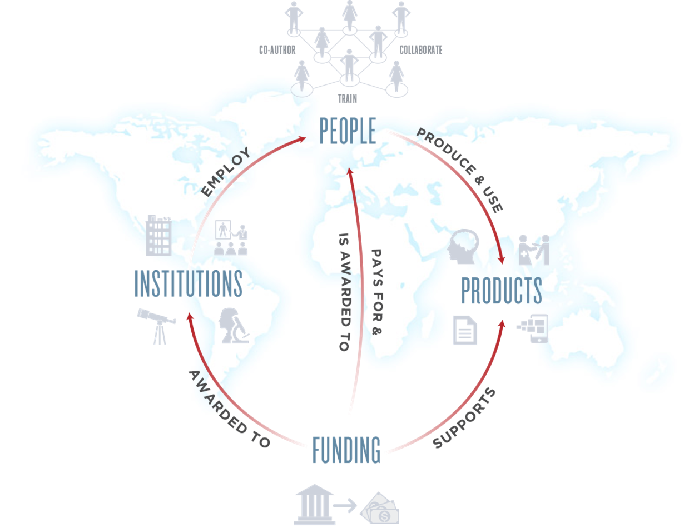
Conceptual Framework

Slide 5
Empirical Framework
Level 1: Document science inputs: the workforce and equipment expenditures supported by federal funding
Level 2: Develop an open automated data infrastructure and tools that will enable us to document and analyze the inputs, outputs, and outcomes resulting from federal investments in science

Slide 6
U METRICS
Private initiative to use STAR METRICS data from 15 major research universities that comprise the Committee on Institutional Cooperation (CIC) to analyze:
Impact of Science
Structure of research workforce
Optimize research

Slide 7
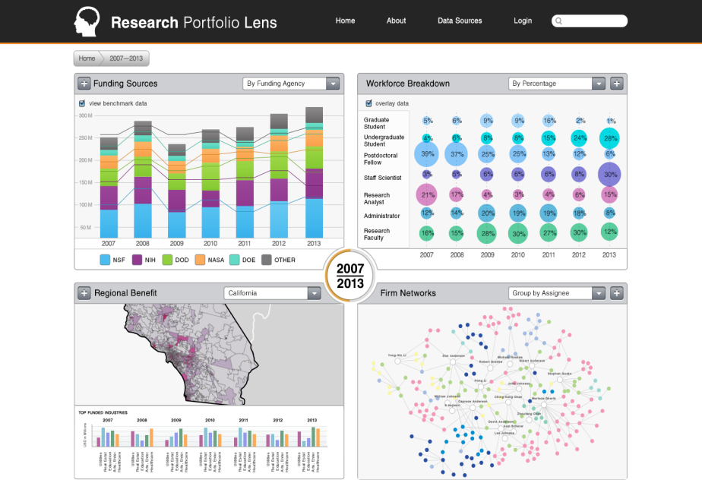
Products
Templated, scalable reports
Integrated dashboard
Open source data infrastructure
Sandbox for research to develop tools

Slide 8
The CIC
University of Chicago
University of Illinois
Indiana University
University of Iowa
University of Maryland
University of Michigan
Michigan State University
University of Minnesota
University of Nebraska-Lincoln
Northwestern University
Ohio State University
Pennsylvania State University
Purdue University
Rutgers University
University of Wisconsin-Madison

Slide 9
The CIC
Most of the leading research universities in the Midwest United States
$9.3B in research
“Shanghai” ARWU range from #8 (U Chicago) to 68; median ranking is 35

Slide 10
U METRICS Projects
Impact, NSF Funded
Analyze distribution, geographic location, and industry of vendors
Analyses the collaborative networks supported by research funding
Offers the first comprehensive picture of the effects of federal R&D on economic resilience and job creation
Training (Discuss tomorrow), NSF Funded
Food Security, US Dept. of Agriculture proposal
Impact from federally funded research targeted at the agricultural sector in general and food safety in particular
Communication, NSF proposal
How new comp sci, data, and tools can inform policymakers’ attitudes, decisions, and understanding of WHAT science research is funded and with what RESULTS
Innovation and Aging, National Institute on Aging proposal
Understand impact and responses to aging innovative workforce
Build data infrastructure to support research

Slide 12
CIC Activity: Economic Impacts
 | Zoom Out |  |  |  | Zoom In
Analysis of: | Entire scientific enterprise | Scientific fields | Entire research institutions and funders | Specific fields at specific institutions | Specific labs, researchers
Useful for: | Government and institutions to justify and set level of science investments | Government to justify and allocate investments to fields | Institutions and funders to document performance | Identify best-practices, target investments | Micro-benchmark performance, identify underexploited opportunities
Method: | Econometric analysis | Econometric analysis | Bibliometric, Text, + Econometric | Bibliometric, Text, + Econometric | Bibliometric, Text, + Econometric
Status: | In progress | In progress | Planned | Planned | Planned

Slide 13
Training Environments Project
Funded by National Science Foundation
Uses CIC STAR METRICS LEVEL I data
Researchers from OSU, Iowa, Illinois, Penn State, Chicago and AIR
Examines the impact of different research funding structures on the training of future scientists, particularly graduate students and postdoctoral fellows, and the impact on their subsequent outcomes.
Link the data to universe data on student jobs, earnings and industries
Uses computer science technologies that permit the capture of information from text documents – to describe what research the students are being trained in

Slide 14
Building a Social Science Research Community around a new R&D Data Infrastructure
Funded by National Science Foundation
Uses CIC STAR METRICS Level 1 Data
Researchers Jason Owen Smith and Maggie Levenstein, University of Michigan
Analyses the distribution, geographic location, and industry of vendors that supply federally funded research,
Analyses the collaborative networks supported by research funding
Offers the first comprehensive picture of the effects of federal R&D spending on economic resilience and job creation via companies that support university research.

Slide 15
Proposed study on food safety
Proposed to USDA
Uses CIC STAR METRICS Level 1 data
Researchers: Kaye Husbands Fealing, University of Minnesota
Goal: Outcomes and impacts from federally funded research targeted at the agricultural sector in general and food safety in particular.
Basic facts: What expenditures have been made in food safety and security and how have these expenditures changed over time? Who is doing research in food safety and What are the research outputs that are most relevant in the near and longer term to food safety and food security in the United States and abroad.
What is the competitive advantage is for each of the universities, and to shed light on how to facilitate technology transfer without changing the main mission of the University—that is to educate students and do high quality faculty research.

Slide 16
Proposed study on communicating research to policy makers
Proposed to NSF
Use CIC STAR METRICS Level 1 data
Researchers: U of Nebraska, Chicago, Maryland, AIR, and OSU
Goal: the extent to which new computer science techniques, new data, and new tools can inform policymakers’ attitudes, decisions, and understanding of WHAT science research is funded and with what RESULTS

Slide 17
Complementary Aging Project
Proposed to NIA(ging) to
Document aging of biomedical research workforce
Estimate effect on innovation, health, and economy
Make policy recommendations
Team from NBER, Albany, Harvard, Illinois, Maryland, MIT, OSU, Stanford, UCSD, Waterloo
Develop STAR METRICS Level II Data Infrastructure: link researchers to their support (grants) ➔ scientific output (publications and citations) ➔ technological products (patents and drug approvals) ➔ Impacts (Health and economy)

Slide 18
What goes back to CIC
Reports and analyses
Dashboard that links funding (top left), STAR METRICS Level 1 data (top right and bottom left( and results (bottom right)

Slide 19
International Context
ASTRA (Australia)
HELIOS (France)
CAELIS (Czech Republic)
NORDSJTERNEN (Norway)
STELLAR (Germany)
TRICS (UK)
SOLES (SPAIN)
First International Workshop in Paris (Sept 16/17) ..which is where Julia, Bruce and Joshua all are!

Slide 20
The U METRICS Initiative
STEM Workforce Training:
A Quasi-Experimental Approach Using the Effects of Research Funding

Slide 21
Overview and Goals
Examine the impact of research environment and funding structures on the training and outcomes of graduate students and post docs
Link to universe data on student jobs, earnings and industries
Use emerging Comp. Sci. methods to mine text of grants to describe what people are being trained in

Slide 22
Teams and Funding Structures
Historically used co-authors, but this is late stage, and selective
1. Labs rather than just co-authors
How to measure a lab?
PI and PI’s funding?
2. Networks (PI collaborations on projects)
How to measure?
Collaborative projects and clusters of projects joined by Pis
Subsequent projects initiated by postdocs or graduates students getting new jobs OR returning to their firms

Slide 23
Automated Data Construction
Most data efforts focus on hand-curated data
Scalable, Low cost / burden: Algorithmically link researchers to their support (grants) ➔ scientific output (publications and citations) ➔ technological products (patents and drug approvals) ➔ Impacts (Health, economy, productivity)
Link to linked employee / employer data
Probabilistic matches

Slide 24
Possible Analyses
Estimate how training environment affects retention in US, sector of employment, wages
Estimate how flows of trainees to companies affects productivity
Measure impact on innovation by linking text of patents to the research done in the labs where people trained
Open the knowledge transfer black box and estimate returns to training

Slide 25
Team
Bruce Weinberg (Ohio State U, Econ)
Julia Lane (American Inst. for Research, Econ)
Lee Giles (Illinois, Comp Sci)
Vetle Torvik (Pennsylvania State, Comp Sci)
Christopher Morphew (Iowa, Educ)
James Evans (U Chicago, Sociology)
Barbara Allen (CIC, Executive Director)
Roy Weiss (U Chicago, Medicine)

